Slide 1
Anticipating Unintended Consequences
of Health Information Technology
and Health Information Exchange
How To Identify and Address Unsafe Conditions Associated with Health IT
By ECRI Institute PSO
Cynthia Wallace, CPHRM, Karen P. Zimmer, MD, MPH, FAAP,
Robert Giannini, NHA, CHTS–IM/CP, Lorraine Possanza, DPM, JD, MBE,
Ronni Solomon, JD

Slide 2
Learning Objectives
Identify how the implementation and use of health information technology (health IT) impacts patient safety
Identify high reliability and culture of safety principles to assist with health IT implementation and improved patient safety
Identify and address health IT issues with the assistance of EHR developers, healthcare organizations, policymakers, oversight authorities, and PSOs

Slide 3

Introduction
Health IT can provide multiple benefits to enhance patient care if:
the technology is optimally designed by the system developer;
thoughtfully implemented by the health care organization; and
appropriately used by the organization’s staff.

Slide 4

Introduction
Health IT’s potential can be undermined by the hazards that arise when a health IT system operates in unintended and unanticipated ways.

Slide 5
Benefits of Health IT
Reduce medication errors
Eliminate illegible writing
Enable computerized provider order entry
Achieve best practices using clinical decision support tools (CDS)
Preventive care recommendations
Track immunizations, testing, and referrals
Centralize patient records (availability, timeliness)
Allow access across a variety of settings for care coordination
Health IT Patient Safety Action Plan and Surveillance Plan (July 2, 2013)

Slide 6
Health IT Safety: A Shared Responsibility
Health IT Safety
Health Care Organizations
Internal reporting of incidents, near misses, unsafe conditions
Patient Safety Organizations
Analysis of aggregated data, feedback, education
EHR Developers
Safety alerts, software updates
Federal and State Authorities
Guidance from agencies of the Department of Health and Human Services, as well as state licensing authorities
Notes:
Ultimately, a healthcare organization’s approach to health IT safety relies on the collective guidance provided by internal and external experts as depicted in the figure “Health IT Safety: A Shared Responsibility.” Working together, healthcare organizations, PSOs, health IT vendors and software developers, and others can learn how to achieve the full potential of health IT.

Slide 7



Examples of Health IT Systems
Administrative – medical billing and scheduling management system
Automated dispensing system
Computerized medical devices
Electronic health records (EHR) or EHR component
Human interface device
Laboratory information system
Radiology/diagnostic imaging system
Notes:
Health IT involves the exchange of health information in an electronic environment as in the following examples.
Administrative – medical billing and scheduling practice management system
Coding/billing system
Master patient index
Registration/appointment scheduling system
Automated dispensing system
Medication dispensing cabinet
Computerized medical devices
Infusion pumps with dose-error-reduction capability (i.e., “smart” pumps)
Patient monitoring systems (e.g., cardiac, respiratory, fetal)
Electronic health records (EHR) or EHR component
Bar-coded medication administration
Clinical decision support system
Clinical documentation system (e.g., progress notes)
Computerized provider order entry
Electronic medication administration record
Pharmacy system
Human interface device
Keyboard
Monitor/display
Mouse
Printer
Speech recognition system
Touchscreen
Laboratory information system
Microbiology system
Pathology system
Test results reporting
Radiology/diagnostic imaging system
Picture archiving and communication system

Slide 8
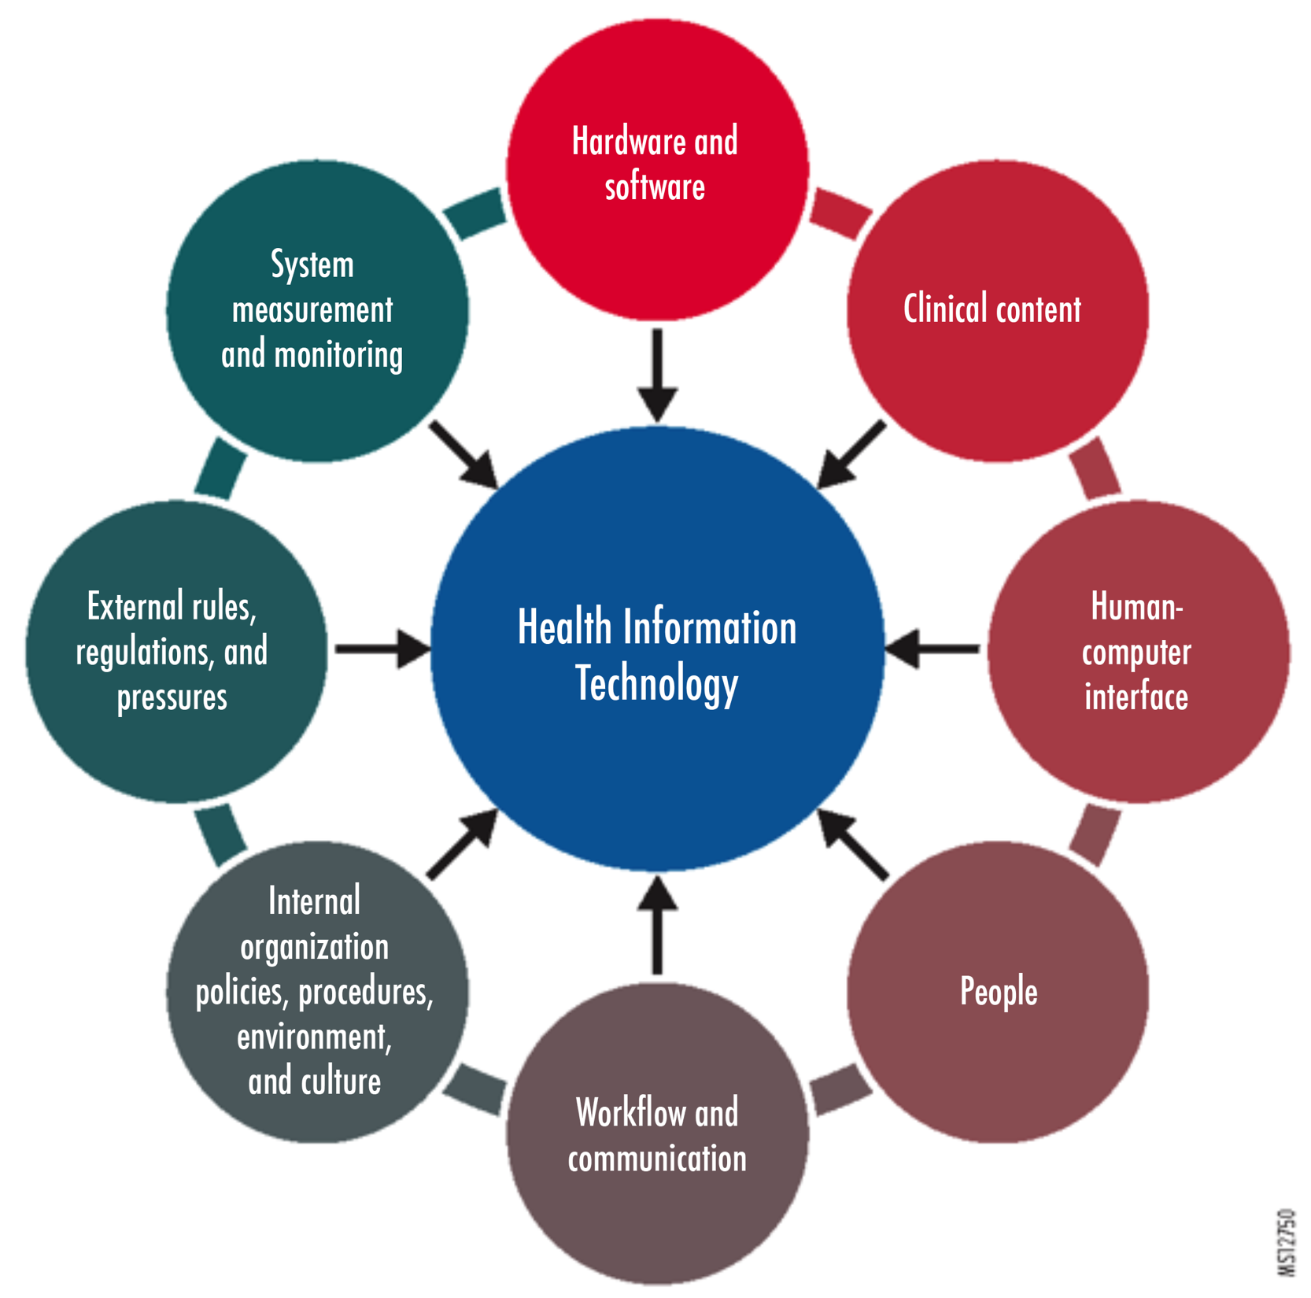
Socio-Technical Model for Health IT
Adapted by permission from BMJ Publishing Group Limited. Sitting DF and Singh H. A new socio-technical model for studying health information technology in complex adaptive healthcare systems. Quality and Safety in Health Care. 19(Supplement 3): i68-74, October 2010; doi: 10.1136/qshc.2010.042085
Notes:
As with many events involving medical technology, health IT-related incidents, such as those described above, do not occur in isolation. The technology operates within a complex environment, and health IT must be considered in the context of that environment. In trying to understand why an event occurs, researchers have developed a socio-technical model for evaluating health IT within the context of eight dimensions (Sittig and Singh “A New Socio-technical Model”), as illustrated in Figure 2: “Socio-technical Model for Health IT.”
Discuss the 8 dimensions incorporated into the complex working environment. (next slide)

Slide 9









The Eight Dimensions of the Socio-Technical Model
Hardware and software
Clinical content
Human-computer interface
People
Workflow and communication
Internal organizational policies, procedures, environment, and culture
External rules, regulations, and pressures
System measurement and monitoring
Adapted by permission from BMJ Publishing Group Limited. Sitting DF and Singh H. A new socio-technical model for studying health information technology in complex adaptive healthcare systems. Quality and Safety in Health Care. 19(Supplement 3): i68-74, October 2010; doi: 10.1136/qshc.2010.042085
Notes:
The eight dimensions of a socio-technical model for evaluating health IT are as follows:
Hardware and software (e.g., computers, keyboards, data storage, software to run health IT applications)
Clinical content (data, information, and knowledge stored in the system)
Human-computer interface (hardware and software interfaces that allow users to interact with the system)
People (software developers, IT department personnel, clinicians, healthcare staff, patients, and others involved in health IT development, implementation, and use)
Workflow and communication (steps followed to ensure patients receive the care they need at the time they need it)
Internal organizational policies, procedures, environment, and culture (internal organizational factors, such as capital budgets, IT policies, and event reporting systems, which affect all aspects of health IT development, implementation, use, and monitoring)
External rules, regulations, and pressures (external forces, such as federal and state rules to ensure privacy and security protections and federal payment incentives to spur health IT adoption)
System measurement and monitoring (processes to measure and monitor health IT features and functions)
In short, examining health IT incidents within the context of the socio-technical model enables organizations to look beyond the incident to understand it in the context of the people who use the system and the other technologies and processes affected by health IT. Understanding these interactions enables high-reliability organizations to make improvements to their health IT systems when flaws in the systems are identified that can lead to patient harm.

Slide 10
Common Health IT Issues
Human-computer
A patient was not identified properly, and all clinical information was entered into the wrong record.
Data were entered incorrectly into the electronic record due to multiple records being open.
The system failed to alert the user of an identified concern with a flag or po- up.
The user ignored or overrode an alert.
Data were not entered into the system.
Data were incomplete and missing from the entry.
Computer-related
Data were not displaying properly in the system.
The network was down or slow.
Interface issues with the laboratory system caused delays in the ability to retrieve data.
The software was not up to date.
Software did not meet the needs of the specialty provider.
The software was not functioning properly.
Data were lost.

Slide 11
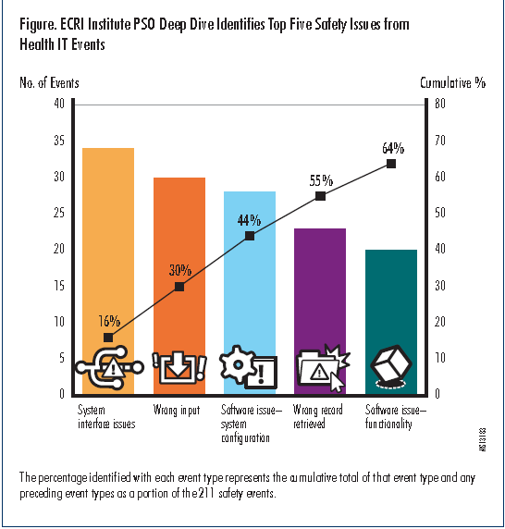
System interface issues
Wrong input
Software issue – system configuration
Wrong record retrieved
Software issue – functionality
Notes:
Using a taxonomy designed for in-depth analysis of health IT-related incidents (Magrabi et al.), ECRI Institute PSO, one of the first PSOs to be federally certified, conducted an evaluation of health IT-related events and unsafe conditions to advance the healthcare sector’s understanding of the technology and its impact on healthcare delivery.
In its report ECRI Institute PSO Deep Dive: Health Information Technology, the PSO shared information learned from the events, as well as strategies to ensure health IT is appropriately implemented and used to improve healthcare quality without jeopardizing patient safety (ECRI Institute PSO).
ECRI Institute PSO’s Deep Dive analysis evaluated more than 170 health IT-related events reported by 36 healthcare organizations over a nine-week period. The events ranged from data entries in the wrong patient records to gaps in reporting critical test results because the results could not be relayed electronically from one system to another. Some events involved more than one safety issue; consequently, the analysis identified 211 patient safety issues that were grouped into 22 event categories.
Computer-related Issues
System Interface
System/Software Configuration
Software Function
Human-computer Issues
Wrong Data Input
Wrong record retrieved

Slide 12
Identifying Health IT’s Unintended Consequences
Continuous Feedback Approach to Health IT System Safety
Identify risks
Analyze risks
Monitor effectiveness
Consider mitigation strategies
Implement best approaches
Notes:
As healthcare organizations build a new foundation for care delivery with their health IT systems, they must not presume that the systems will always operate as planned, nor that patient safety is assured with these systems. Indeed, high-reliability organizations make safety their number one priority and approach safety systematically.
The high-reliability organization must maintain a never-ending, closed-loop approach to health IT system safety. As depicted in this figure: “Continuous Feedback Approach to Health IT System Safety,” this approach requires continually monitoring for possible unintended consequences of health IT from the time the technology is first tested in the organization and throughout its full implementation and operation. If any safety risks are identified, the organization must examine the causes of these risks, consider strategies to eliminate the risks, select and implement the most effective risk-reduction strategies, and monitor these strategies to ensure they are working as intended.
The goal for healthcare organizations in tracking and addressing the unintended consequences of health IT systems is to design robust processes to capture the problems that users encounter with the systems so that they can be addressed before any patients are harmed. The organization must, therefore, have processes in place to identify problems that can occur with the technology when it is first tested and implemented, as well as capture important information about health IT-related vulnerabilities throughout the system’s operation in the organization.

Slide 13
High-Reliability Organizations’ Commitment to Health IT Safety
Leadership commitment to:
Educating staff about health IT safety
Advocating health IT safety as everyone’s responsibility
Promoting open communication about health IT safety concerns
Empowering staff to identify, report, and reduce hazards and risks from health IT systems
Allocating adequate resources to ensure health IT safety
Notes:
High-Reliability Organizations’ Commitment to Health IT Safety
Of course, for the organization’s approach to health IT safety to be successful, the high-reliability organization must build a culture that supports staff reporting of problems that they encounter.
The foundation for this culture is leadership commitment to safety. Leaders can establish this culture with the following actions:
Educating staff about health IT safety
Advocating health IT safety as everyone’s responsibility
Promoting open communication about health IT safety concerns
Empowering staff to identify, report, and ameliorate hazards and risks from health IT systems
Establishing a blame-free environment for reporting any health IT-related problems (including errors and near misses) without fear of punishment or reprisal
Allocating adequate resources to ensure health IT safety

Slide 14
Event Reporting Within a Culture of Safety
Establishing a blame-free environment for robust reporting of any health IT-related problems (including errors and near misses) without fear of punishment or reprisal
Encourage reporting of errors, near misses, and unsafe conditions with a clearly defined response
Expectation of accountability with constructive feedback and fair-minded treatment to facilitate organizational learning

Slide 15
How To Collect Health IT Event Data
Reporting system should enable reporters to provide sufficient information, in a standardized format, to identify the health IT problems they encountered
Standardized tools for event reporting
AHRQ Common Formats for Health IT events
AHRQ Health IT Hazard Manager
Staff training and education about Health IT event reporting

Slide 16
How To Collect Health IT Event Data
What to include in a health IT-related event report:
The event reporting system should capture enough information so that those analyzing the event can pinpoint specific health IT-related issues

Slide 17
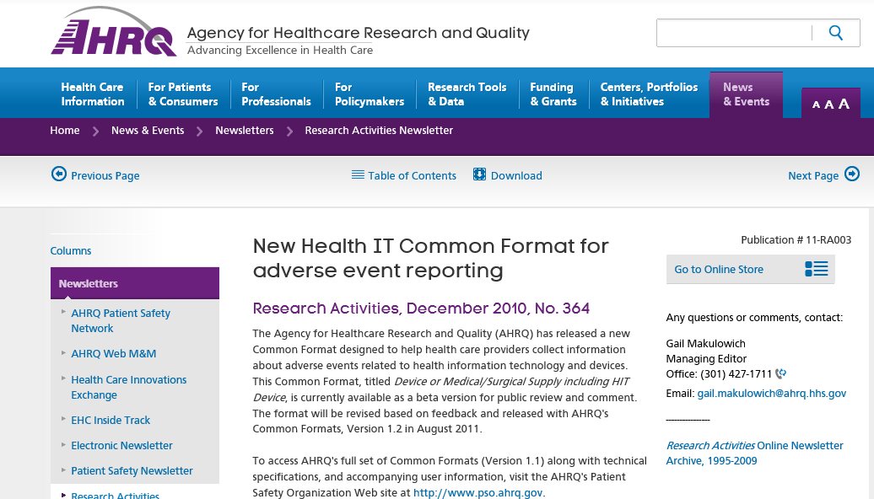
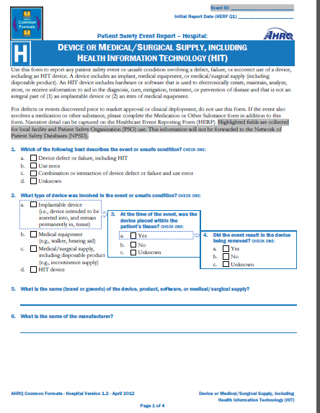
How To Collect Health IT Event Data
Standardized tools:
AHRQ Common Format for Health IT Event

Slide 18
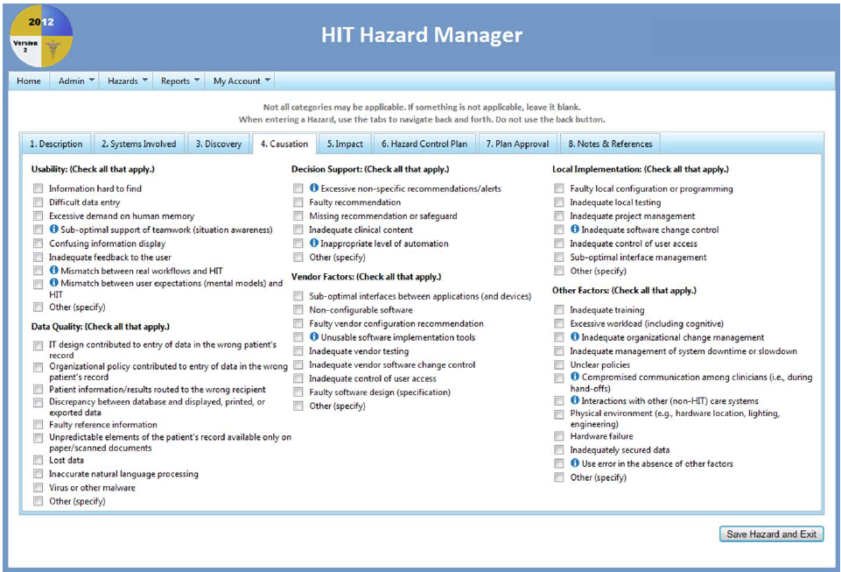
How To Collect Health IT Event Data
Standardized tools:
AHRQ Health IT Hazard Manager
Source: Walker JM, Hassol A, Bradshaw B, et al. Health IT Hazard Manager Beta-Test: Final Report [online]. AHRQ Publication No. 12-0058-EF. Rockville (MD): Agency for Healthcare Research and Quality; 2012 May. http://healthit.ahrq.gov/sites/default/files/docs/citation/HealthITHazardManagerFinalReport.pdf.

Slide 19
Health IT Event and Data Analysis
Case Study: Health IT Laboratory Event
Critical lab results were overlooked without full interface for different health IT systems.
Consider the following poorly designed health IT system interface that hindered the reporting of critical laboratory results to patients’ physicians and eventually led to a fatal event:
Notes:
Critical lab results overlooked without full interface for different Health IT systems
Consider the following poorly designed health IT system interface that hindered the reporting of critical laboratory results to patients’ physicians and eventually led to a fatal event:
The interface between the hospital’s laboratory information system and its transplant surgery database only allowed certain laboratory test results to reach the transplant database.
The transplant team had to access the laboratory system and the organization’s EHR for additional test result information.
In this particular event, the coordinator deleted the notification but did not enter an action item in the transplant database.
Several months after the laboratory tests were conducted, the patient died as a result of organ transplant rejection.
Upon the patient’s admission to the hospital for treatment for the failing transplant, staff discovered the original test result in the organization’s EHR, which had indicated pending organ failure. The physician had never seen the test result to act on its findings.
In this particular event, the coordinator deleted the notification but did not enter an action item in the transplant database.
Several months after the laboratory tests were conducted, the patient died as a result of organ transplant rejection.
Upon the patient’s admission to the hospital for treatment for the failing transplant, staff discovered the original test result in the organization’s EHR, which had indicated pending organ failure. The physician had never seen the test result to act on its findings.

Slide 20
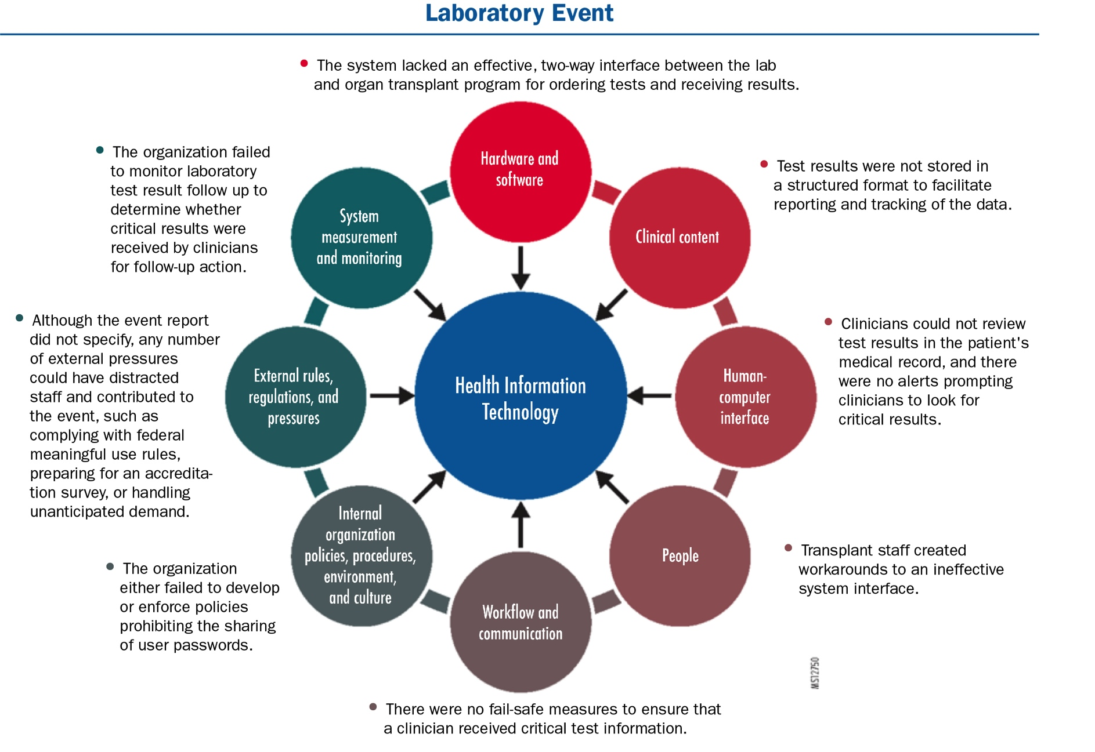
Health IT Event and Data Analysis
Case Study: Health IT Laboratory Event
Adapted by permission from BMJ Publishing Group Limited. Sitting DF and Singh H. A new socio-technical model for studying health information technology in complex adaptive healthcare systems. Quality and Safety in Health Care. 19(Supplement 3): i68-74, October 2010; doi: 10.1136/qshc.2010.042085
Notes:
Using the eight dimensions of the socio-technical model, the organization can begin to conduct an in-depth examination of the event to understand how and why the health IT event occurred and, ultimately, to identify and design strategies to prevent similar events. Here is a partial look at what each dimension might reveal about the particular event:
Hardware and software. The system lacked an effective, two-way interface between the lab and organ transplant program for ordering tests and receiving results.
Clinical content. Test results were not stored in a structured format to facilitate reporting and tracking of the data.
Human-computer interface. Clinicians could not review test results in the patient’s medical record, and there were no alerts prompting clinicians to look for critical results.
People. Transplant staff created workarounds to an ineffective system interface.
Workflow and communication. There were no fail-safe measures to ensure that a clinician received critical test information.
Internal organizational policies, procedures, environment, and culture. The organization either failed to develop policies prohibiting the sharing of user passwords or established a culture that tolerated deviance from organization policies.
External rules, regulations, and pressures. Inability to meet federal requirements for health IT privacy and security protections may have stopped the organization from building an effective and complete interface between the laboratory information system and the transplant database.
System measurement and monitoring. The organization failed to monitor laboratory test result follow up to determine whether critical results were received by clinicians for follow-up action.

Slide 21
Monitoring and Staff Feedback
Monitoring
Organizations must monitor the effectiveness of their event reporting programs to ensure staff know:
How to use the program
That the program is capturing the data needed for continuous improvement
Staff Feedback
Analysis of event(s)
Error-prevention strategies

Slide 22
Monitoring and Staff Feedback
Other sources of information:
Discussion with users
Helpdesk logs maintained by the IT Department
Medical chart reviews
Claims data
Executive staff walk-arounds

Slide 23
Reporting Health IT Events to Patient Safety Organizations
PSOs can receive, review, and analyze information about health IT-related patient safety events.
EHR developers can report health IT patient safety events to PSOs.
PSOs enable confidential and protected expert review and analysis.
PSOs aggregate and analyze large volumes of data for facilitated learning.

Slide 24
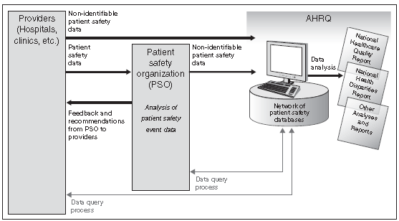
Reporting Health IT Events to Patient Safety Organizations
Intended Flow of Patient Safety Event Data and Feedback
Source: U.S. Government Accountability Office (GAO). Patient Safety Act: HHS is in the process of implementing the Act, so its effectiveness cannot yet be evaluated. GAO-10-281. Washington (DC): GAO; 2010 Jan. http://www.gao.gov/assets/310/300382.pdf.

Slide 25
EHR Developers’ Role In Ensuring Patient Safety
Support patient safety in their product design, development, and deployment.
Share best practices with customers for safe deployment, implementation, maintenance, and use of their products.
Participate with one or more PSOs for reporting, reviewing, and analyzing health IT-related patient safety events.
Notify customers when they identify or become aware of software issues that could materially affect patient safety and to offer solutions.
Recognize the value of their customers’ participation in discussions about patient safety and not contractually limit their customers from discussing patient safety issues in appropriate venues.

Slide 26
EHR Developers’ Role In Assuring Patient Safety
Teaming Up with PSOs
There are three ways in which EHR developers might work with providers and PSOs under the framework of the Patient Safety Act:
Serving as a contractor to a PSO
Serving as a contractor to a provider
Creating a component organization to seek listing and serve as a PSO.
See also: AHRQ’s FAQs about PSOs
Notes:
There are three ways in which EHR developers might work with providers and PSOs under the framework of the Patient Safety Act:
Serve as a contractor to a PSO. PSQIA permits a PSO to contract with another entity, such as a vendor, to disclose patient safety information about health IT systems that is classified as patient safety work product (PSWP). Under the law, PSWP is given confidentiality and privilege protections, so the contracting entity is not permitted to disclose the information unless the disclosure is deemed permissible.
Serve as a contractor to a provider. The provider can contract with another entity, such as a health IT vendor, to submit patient safety reports to a PSO on behalf of the provider working with the PSO.
Create a component organization to seek listing and serve as a PSO. While a vendor or software developer cannot become federally certified as a PSO, it can create a component organization that can become a PSO. Operating under the requirements that apply to all PSOs, the component PSO could receive and analyze patient safety events and hazards involving health IT.

Slide 27
Conclusion
Health IT is changing the landscape of health care.
It is important to recognize the benefits and the potential pitfalls of health IT.
Reporting health IT events and near-misses will facilitate learning.
Improvements will occur when involving multiple stakeholders (providers, EHR developers, policymakers, human factor analysts).

Slide 28
Resources
AHRQ Common Format: Device or Medical/Surgical Supply, Including Health Information Technology (Health IT) Form
AHRQ’s FAQs about PSOs
EHR Contracts: Key Contract Terms for Users to Understand
Electronic Health Record Association’s EHR Developer Code of Conduct Principles
Health IT Hazard Manager Beta-Test: Final Report
How to Identify and Address Unsafe Conditions Associated with Health IT
ONC’s Health Information Technology: Patient Safety Action & Surveillance Plan
Institute of Medicine’s report, Health IT and Patient Safety: Building Safer Systems for Better Care

Slide 29
References
Agency for Healthcare Research and Quality (AHRQ):
Device or medical/surgical supply, including health information technology (HIT) [online]. In: Hospital Common Formats—version 1.2: Event Descriptions, Sample Reports, and Forms. 2013 Apr 24 [cited 2013 Aug 20]. https://www.psoppc.org/web/patientsafety/version-1.2_documents.
PSO FAQs [online]. [cited 2013 Aug 27]. http://www.pso.ahrq.gov/psos/fastfacts.htm.
Ash JS, Berg M, Coiera E. Some unintended consequences of information technology in health care: the nature of patient care information system-related errors. J Am Med Inform Assoc 2004 Mar-Apr;11(2):104-12.
ECRI Institute PSO. ECRI Institute PSO Deep Dive: Health Information Technology. Plymouth Meeting (PA): ECRI Institute PSO; 2012 Dec:1-41.
Electronic Health Record Association (EHRA). EHR Developer Code of Conduct Principles [online]. 2013 Jun 11 [cited 2013 Aug 27]. http://www.himssehra.org/docs/EHR%20Developer%20Code%20of%20Conduct%20Final.pdf.
Institute of Medicine (IOM). Health IT and Patient Safety: Building Safer Systems For Better Care. Washington (DC): National Academies Press; 2011 Nov 8.
Kaushal R, Shojania KG, Bates DW. Effects of computerized physician order entry and clinical decision support systems on medication safety: a systematic review. Arch Intern Med 2003 Jun 23;163(12):1409-16.

Slide 30
References
Koppel R, Metlay JP, Cohen A, et al. Role of computerized physician order entry systems in facilitating medication errors. JAMA 2005 Mar 9;293(10):1197-203.
Magrabi F, Ong MS, Runciman W, et al. Using FDA reports to inform a classification for health information technology safety problems. J Am Med Inform Assoc. 2012;19(1):45-53.
Office of the National Coordinator for Health Information Technology (ONC). Health Information Technology: Patient Safety Action & Surveillance Plan [online]. 2013 Jul 2 [cited 2013 Aug 26]. http://www.healthit.gov/sites/default/files/safety_plan_master.pdf.
Sittig DF, Singh H:
A new socio-technical model for studying health information technology in complex adaptive healthcare systems. Qual Saf Health Care 2010 Oct;19(Suppl 3):i68-74.
Defining health information technology-related errors. Arch Intern Med 2011 Jul 25;171(14):1281-4.
Sparnon E, Marella WM. The role of the electronic health record in patient safety events. Pa Patient Saf Advis. 2012;9(4):113-21.
U.S. Food and Drug Administration (FDA). Class 2 Recall: ED Pulsecheck [online]. 2013 Jul 29 [cited 2013 Sep 15]. http://www.accessdata.fda.gov/scripts/cdrh/cfdocs/cfRes/res.cfm?ID=119832.
Walker JM, Hassol A, Bradshaw B, et al. Health IT Hazard Manager Beta-Test: Final Report [online]. AHRQ Publication No. 12-0058-EF. Rockville (MD): Agency for Healthcare Research and Quality; 2012 May. http://healthit.ahrq.gov/sites/default/files/docs/citation/HealthITHazardManagerFinalReport.pdf.

Slide 31
Extra Slides Details on the Device/HIT AHRQ Common Format Form
Extra Slides Details on the Device/Health IT AHRQ Common Format Form

Slide 32
AHRQ Common Formats – Event Categories
Event-specific categories include:
Blood or blood product
Device or Medical/Surgical Supply, including Health Information Technology (Health IT)
Fall
Healthcare-associated infection
Medication or other substance
Perinatal
Pressure ulcer
Surgery or anesthesia
Other

Slide 33
AHRQ Common Formats – Contributing Factors
Incompatibility between devices
Equipment/device function
Equipment/device maintenance
Hardware failure or problem
Failure of, or problem with, wired or wireless network
Ergonomics, including human/device interface issue
Security, virus or other malware issue
Unexpected software design issue
Notes:
To have a better understanding of HIT Events, we will take a look at the contributing factors according to the AHRQ Common Formats. Let’s take them one at a time.

Slide 34
AHRQ Common Formats – Contributing Factors
Incompatibility between devices
Equipment/device function
Equipment/device maintenance
Hardware failure or problem
Failure of, or problem with, wired or wireless network
Ergonomics, including human/device interface issue
Security, virus or other malware issue
Unexpected software design issue
Example:
Results from the Laboratory Information System did not interface to the results section of the electronic health record
Notes:
Incompatibility between devices.
Whether you have approached your IT infrastructure as a single integrated platform or you have taken a best of breed approach. You can still have incompatibility between devices. In this case, device = software. This is where you can have issues transporting information from one module to another module or from one system to another system.
For the example in this case. Lab results did not appear in the Electronic Health Record because there were issues when the data was transferred into the system.

Slide 35
AHRQ Common Formats – Contributing Factors
Incompatibility between devices
Equipment/device function
Equipment/device maintenance
Hardware failure or problem
Failure of, or problem with, wired or wireless network
Ergonomics, including human/device interface issue
Security, virus or other malware issue
Unexpected software design issue
Loss or delay of data
System returns or stores data that does not match patient
Image measurement/corruption issue
Image orientation incorrect
Incorrect test results
Incorrect software programming calculation
Incorrect or inappropriate alert
Notes:
Equipment/device function is our next contributing factor. There are many issues that can happen within this category.
They include:
Loss or delay of data
System returns or stores data that does not match patient
Image measurement/corruption issue
Image orientation incorrect
Incorrect test results
Incorrect software programming calculation
Incorrect or inappropriate alert

Slide 36
AHRQ Common Formats – Contributing Factors
Incompatibility between devices
Equipment/device function
Equipment/device maintenance
Hardware failure or problem
Failure of, or problem with, wired or wireless network
Ergonomics, including human/device interface issue
Security, virus or other malware issue
Unexpected software design issue
Example:
When entering a dose in mg/kg/hr, the system inappropriately calculated an incorrect IV rate of infusion

Slide 37
AHRQ Common Formats – Contributing Factors
Incompatibility between devices
Equipment/device function
Equipment/device maintenance
Hardware failure or problem
Failure of, or problem with, wired or wireless network
Ergonomics, including human/device interface issue
Security, virus or other malware issue
Unexpected software design issue

Slide 38
AHRQ Common Formats – Contributing Factors
Incompatibility between devices
Equipment/device function
Equipment/device maintenance
Hardware failure or problem
Failure of, or problem with, wired or wireless network
Ergonomics, including human/device interface issue
Security, virus or other malware issue
Unexpected software design issue
Example:
When entering a dose in mg/kg/hr, the system inappropriately calculated an incorrect IV rate of infusion

Slide 39
AHRQ Common Formats – Contributing Factors
Incompatibility between devices
Equipment/device function
Equipment/device maintenance
Hardware failure or problem
Failure of, or problem with, wired or wireless network
Ergonomics, including human/device interface issue
Security, virus or other malware issue
Unexpected software design issue
Example:
I was working on a mobile workstation trying to complete my documentation, and I was unable to save it.

Slide 40
AHRQ Common Formats – Contributing Factors
Incompatibility between devices
Equipment/device function
Equipment/device maintenance
Hardware failure or problem
Failure of, or problem with, wired or wireless network
Ergonomics, including human/device interface issue
Security, virus or other malware issue
Unexpected software design issue
Hardware location
Data entry or selection
Information display or interpretation
Alert fatigue/alarm fatigue

Slide 41
AHRQ Common Formats – Contributing Factors
Incompatibility between devices
Equipment/device function
Equipment/device maintenance
Hardware failure or problem
Failure of, or problem with, wired or wireless network
Ergonomics, including human/device interface issue
Security, virus or other malware issue
Unexpected software design issue
Example:
I was attempting to select my patient and inadvertently selected the next patient on my list.

Slide 42
AHRQ Common Formats – Contributing Factors
Incompatibility between devices
Equipment/device function
Equipment/device maintenance
Hardware failure or problem
Failure of, or problem with, wired or wireless network
Ergonomics, including human/device interface issue
Security, virus or other malware issue
Unexpected software design issue
Example:
My log-in was not working and I was unable to access the computer system to obtain information on my patient.

Slide 43
AHRQ Common Formats – Contributing Factors
Incompatibility between devices
Equipment/device function
Equipment/device maintenance
Hardware failure or problem
Failure of, or problem with, wired or wireless network
Ergonomics, including human/device interface issue
Security, virus or other malware issue
Unexpected software design issue
Example:
Medication order placed via CPOE. When medication appeared on e-MAR, information related to the drug was omitted.

